Slide 1







Slide 2



1.
BUSINESS PROBLEM
2.
OUR TASK
3.
DATA COLLECTION AND OBSERVATIONS
4.
PROCESS FLOW DIAGRAM
5.
PERFORMANCE MEASURES
6.
SIMULATION OUTPUT
7.
CONCLUSION

Slide 3

BUSINESS PROBLEM
"How can we reduce customer wait times while ensuring a consistently high level of service quality in our organization to enhance customer satisfaction and loyalty?"

Slide 4



OUR TASK
COLLECT RELEVANT DATA
MODEL ARRIVAL RATE AND SERVICE TIME OF CUSTOMERS
IDENTIFY PROBABILTY OF ADDING ANOTHER OPERATOR

Slide 5



DATA COLLECTION AND OBSERVATIONS
70
ORDERS IN 2 HOURS
Data was gathered from 7:00 a.m. to 9:00 a.m in the morning totalling to 70 observations consisting of 36 for Walk In observations and 34 for Drive Thru Observations. We have collected arrival, order placing and service time for both walk-in and drive thru.

Slide 6

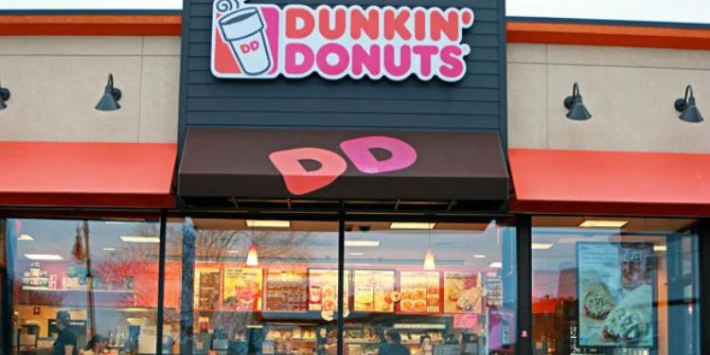
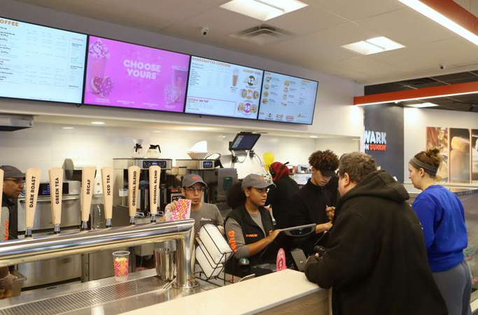
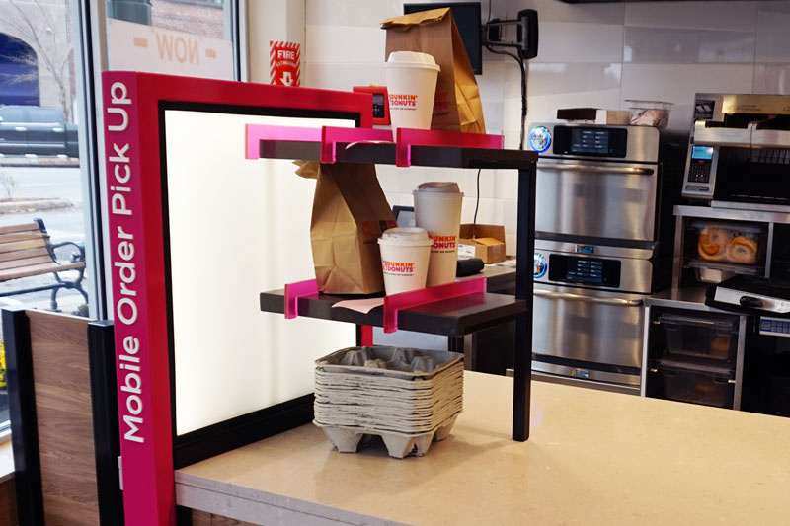
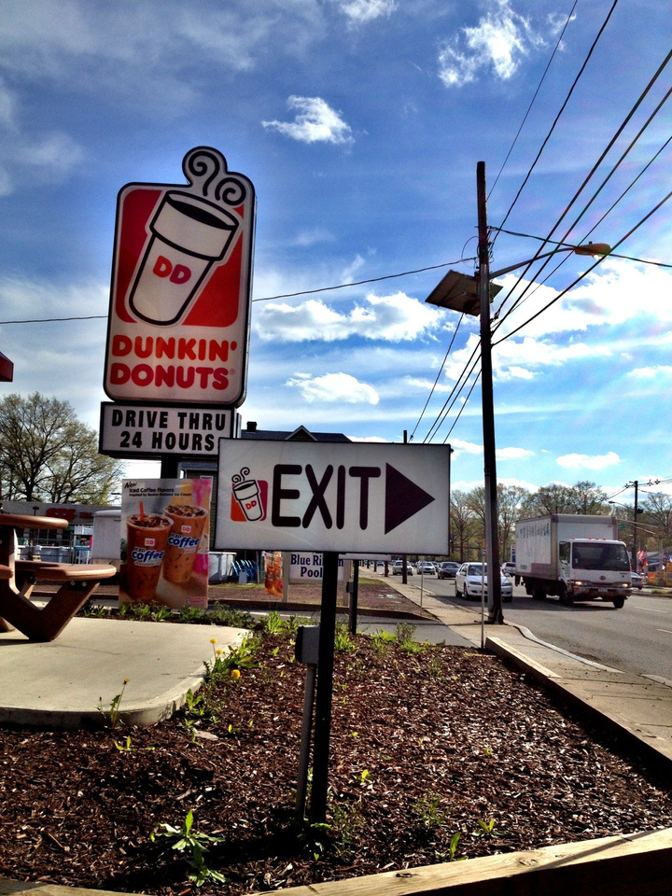

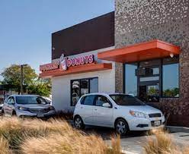
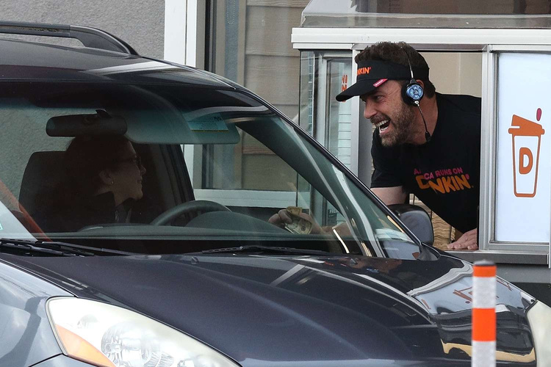
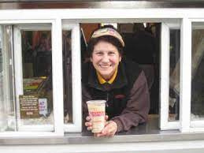
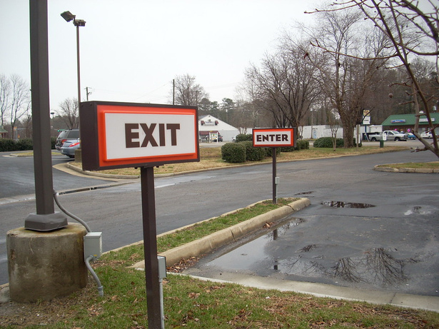
Walkin Entrance
Walkin Order place
Walkin Pickup
Exit
Drive-thru Entrance
Drive-thru Billing
Drive-thru pickup
Exit

Slide 7
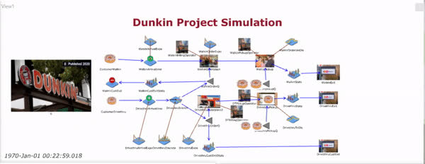
ORIGINAL SIMULATION MODEL

Slide 8
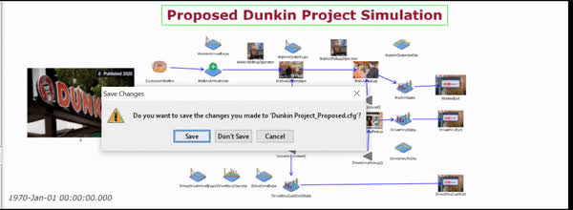
PROPOSED SIMULATION MODEL

Slide 9
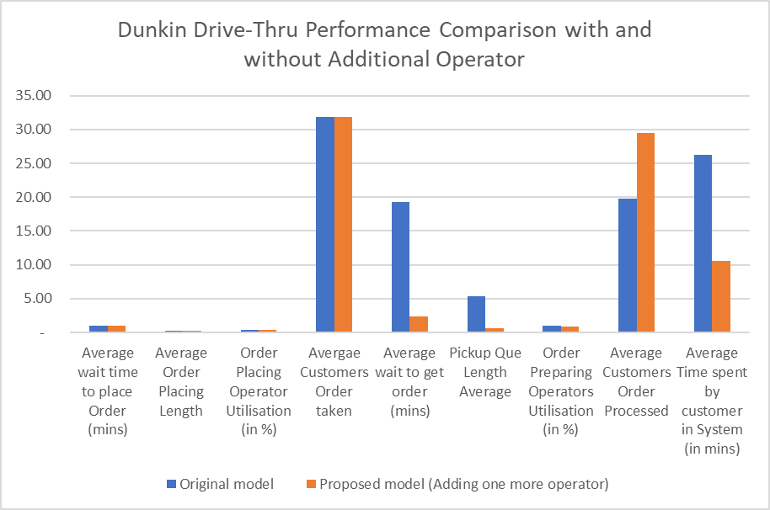
PERFORMANCE MEASURE

Slide 10
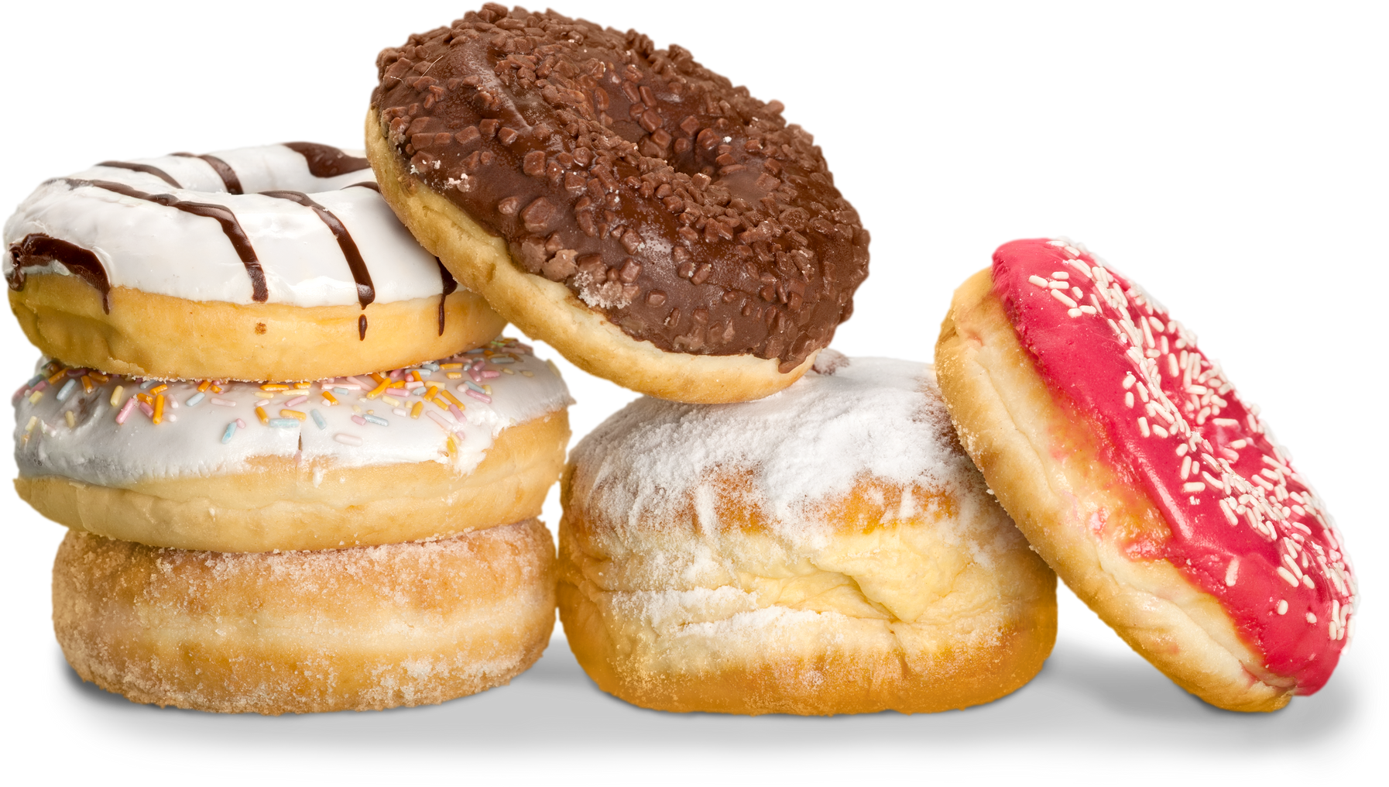
CONCLUSION
ADDING ONE OPERATOR TO THE DRIVE-THRU MODEL IMPROVES EFFICIENCY WITH REDUCED WAIT TIMES, FASTER ORDER PICKUP, INCREASED CAPACITY, AND SHORTER CUSTOMER PROCESSING TIMES, DEMONSTRATING THE VALUE OF STAFF OPTIMIZATION.

